Slide 1
REDUX
What, Why & How

Slide 2
Challenges in State Management
Prop drilling (passing data through many layers).
State duplication across components.
Difficulty in debugging and testing state changes.

Slide 3
What is Redux?
State Container
Created by Dan Abramov
Can be used without react

Slide 4
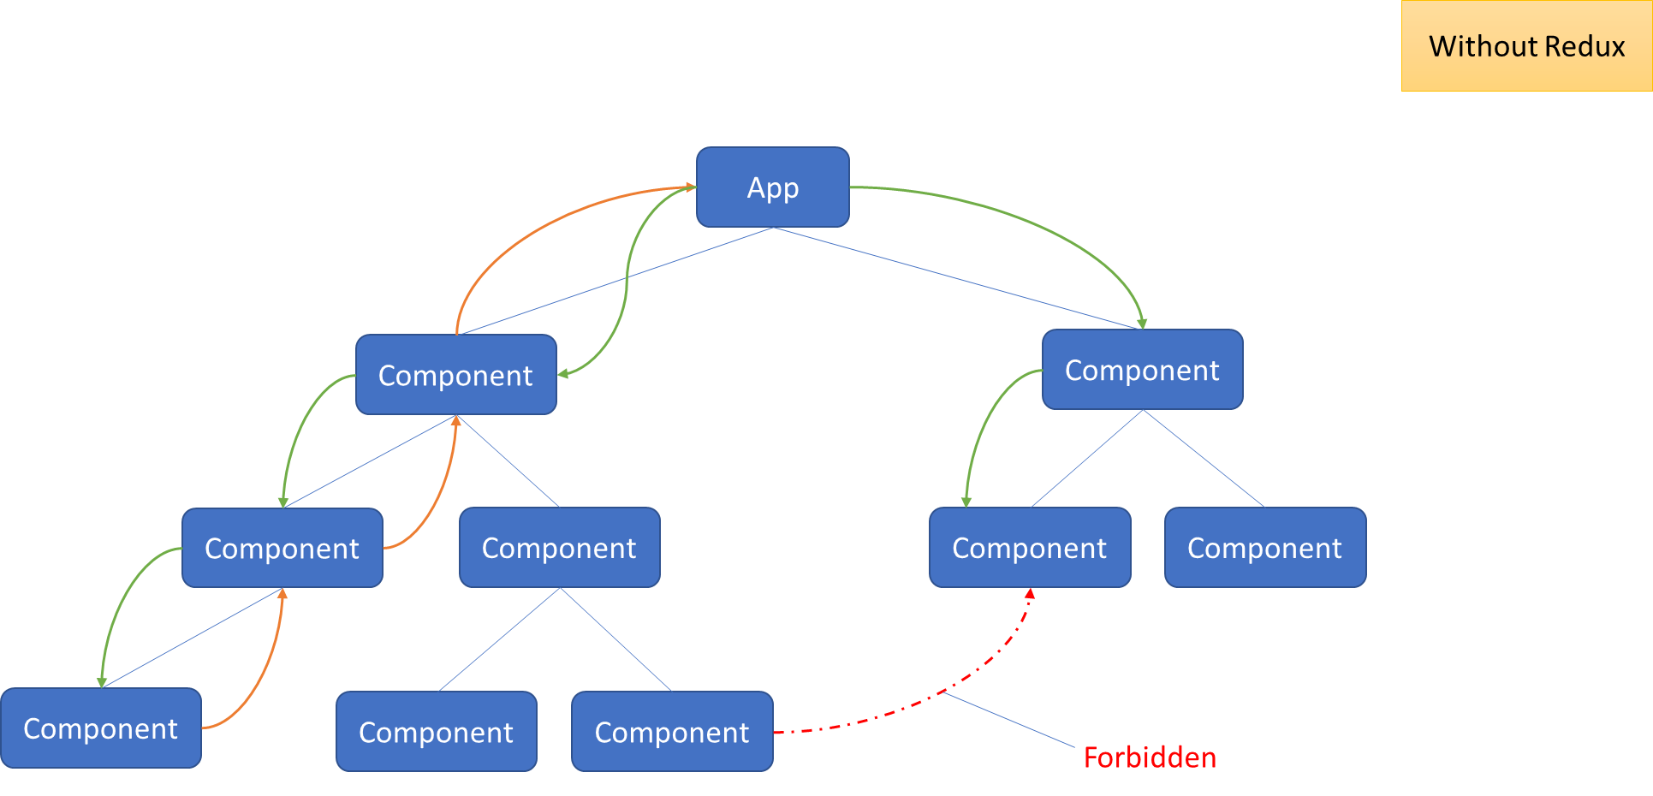

Slide 5
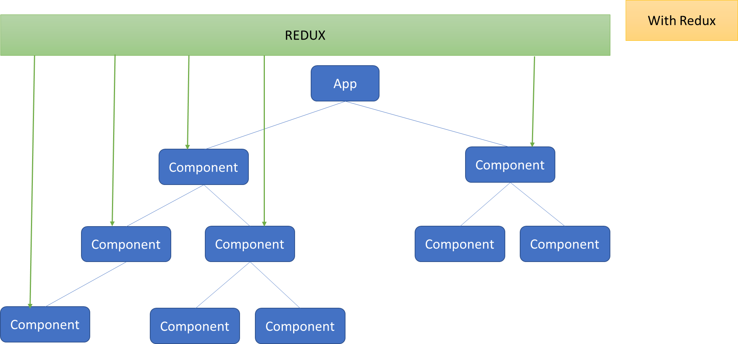

Slide 6
Core Principles of Redux
Single Source of Truth
State is Read-Only.
Changes are Made with Pure Functions.

Slide 7
Redux Architecture
Store:
The store is the single source of truth in Redux. It holds the state of the application and provides methods to access the state, dispatch actions, and subscribe to changes.
Actions:
Actions are plain JavaScript objects that describe what happened in the application. Each action must have a type property that indicates the action's type, and can include additional data as needed.
Reducers:
Reducers are pure functions that specify how the state changes in response to an action. They take the current state and an action as arguments and return a new state.

Slide 8
Redux Architecture
1.User Clicks Button:
A button is clicked by the user.
2.Action Dispatch:
An action ({ type: 'INCREMENT' }) is dispatched to the Redux store.
3.Reducer Handles Action:
The reducer processes the action and updates the state (e.g., increments a counter).
4.State Update:
The Redux store holds the updated state with the new counter value.
5.View Re-render:
The React component connected to the Redux store re-renders to display the updated counter value.

Slide 9


Slide 10
React-Redux Components
Provider:
Makes the Redux store available to the entire application.
useSelector and useDispatch Hooks:
Hooks for accessing state and dispatching actions in functional components.

Slide 11
Redux Toolkit (RTK)
What is RTK?
An official, opinionated, and integrated toolset for efficient Redux development.
Goal:
Simplify the process of writing Redux logic and improve developer experience.

Slide 12
Benefits of Using RTK
Less Boilerplate: Reduces the amount of code needed to set up Redux.
Built-in Best Practices:Encourages using recommended patterns and configurations.
Easier Configuration: Provides a streamlined setup for Redux stores.

Slide 13
Key Features of RTK
configureStore: Simplifies store creation with sensible defaults.
createSlice: Generates action creators and reducers automatically.
createAsyncThunk: Simplifies handling of asynchronous operations like data fetching.

Slide 14
Thank You

